Slide 1



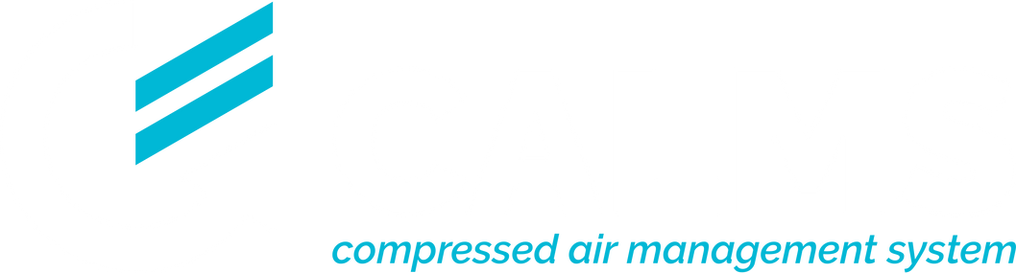
NEXT-GEN MAINTENANCE: LEVERAGING IOT AND OPERATOR LOGS FOR TOTAL SYSTEM HEALTH
Leveraging IoT for Real-Time Monitoring and Maintenance of Compressed Air Systems Digital Daily Logs
Presenter:
Gorazd Bregar
Date:
July 2025
Independent Compressed Air Management System

Slide 2

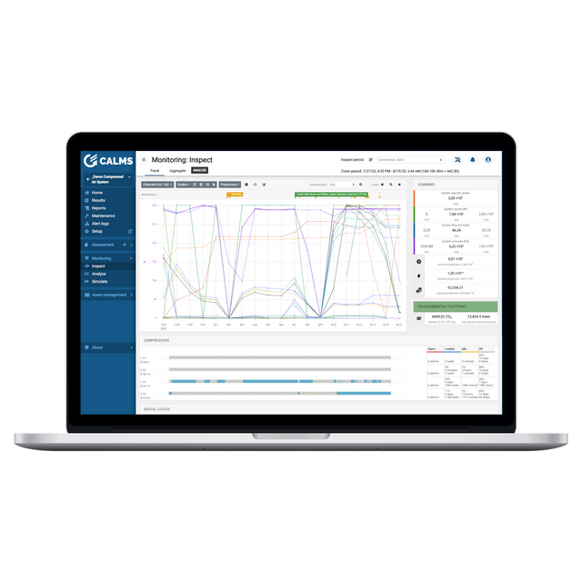

About us
  Independent Compressed Air Management System for continuous improvements and energy savings with AI-based Auto Analyzers
  Since 2008, team of CA experts Worldwide and software developers,
  Holistic, Action driven, Independent, Employee Engagement
  Based on CSA837, support for ISO 11011, 50001, 55000 compliant
  Supported by independent experts coalition CATZ Worldwide
  CALMS Offices: USA, Slovenia, Sweden
  1300+ CA systems Worldwide
GLOBAL CONTROL - LOCAL SUPPORT
Certified by:
Notes:
CALMS is an innovative Energy Management System designed to optimize compressed air systems, enhancing efficiency and sustainability in industrial settings.
By integrating advanced monitoring, real-time analytics, and predictive maintenance, CALMS ensures operational excellence, reduces energy consumption, and minimizes environmental impact.
It's the go-to solution for businesses seeking to improve their energy management and achieve cost-effective, eco-friendly operations.

Slide 3
Compressed Air – Preferences
Reliability
nothing is more expensive than production downtime
Highest Compressed Air Quality
to prevent damages and failure of machines, product quality
Low Costs - highest efficiency
no breakdown of costs for compressed air supply, lack of responsibility in the company, lack of time and information
Sustainability
long term balance of performance, cost & environmental impact
Notes:
CALMS is an innovative Energy Management System designed to optimize compressed air systems, enhancing efficiency and sustainability in industrial settings.
By integrating advanced monitoring, real-time analytics, and predictive maintenance, CALMS ensures operational excellence, reduces energy consumption, and minimizes environmental impact.
It's the go-to solution for businesses seeking to improve their energy management and achieve cost-effective, eco-friendly operations.

Slide 4






Reduce. Replace. Optimize. Your Roadmap to Efficient Compressed Air Management
REDUCE DEMAND
ALTERNATIVE SOURCES
OPTIMIZE EFFICIENT USE
Leaks
Artificial demand
Inappropriate uses
Supply system optimization
Controls
Follow These Holistic Steps for Energy Optimisation
System review
Finding
potential
savings
Audit
Supply
Distribution
Demand
Waste
Employee
Training & Engagement
Permanent
monitoring
Optimisations & Controls
Asset management
Notes:
CALMS is an innovative Energy Management System designed to optimize compressed air systems, enhancing efficiency and sustainability in industrial settings.
By integrating advanced monitoring, real-time analytics, and predictive maintenance, CALMS ensures operational excellence, reduces energy consumption, and minimizes environmental impact.
It's the go-to solution for businesses seeking to improve their energy management and achieve cost-effective, eco-friendly operations.

Slide 5
IIoT in Compresssed Air Systems
IIoT – Industrial Internet of Things – use of IoT technologies (sensors, devices, connectivity and data analytics) in industry
Wireless IIoT measurement is using wireless networks (WiFi, BT, LTE, LoRa) to send sensor data to edge gateways and cloud platforms.
Key features use cases in CAS
  Real-time monitoring of energy use, machine operation, processes
  Integration with MES, EMS, ERP, SCADA systems
  Remote access and control of industrial equipment
  Data driven optimization of energy usage, quality, operations, safety, reliability
  Predictive maintenance using sensor data with help of AI (*new)
Focus on
  Reliability: Must work in harsh environments (dust, heat, EMI..)
  Scalability: Handle many connected devices
  Security: Prevent unauthorized access to sensitive industrial data
  Low latency: Near real-time data transfer (e.g., 1–5 sec sample rate)
Notes:
CALMS is an innovative Energy Management System designed to optimize compressed air systems, enhancing efficiency and sustainability in industrial settings.
By integrating advanced monitoring, real-time analytics, and predictive maintenance, CALMS ensures operational excellence, reduces energy consumption, and minimizes environmental impact.
It's the go-to solution for businesses seeking to improve their energy management and achieve cost-effective, eco-friendly operations.

Slide 6


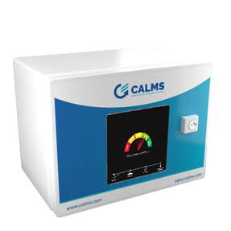


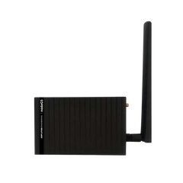
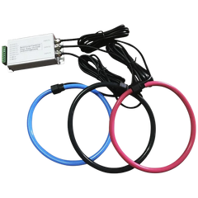

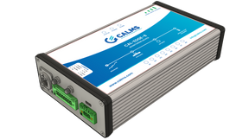
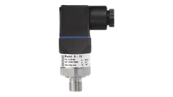
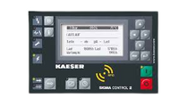
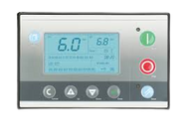
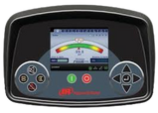

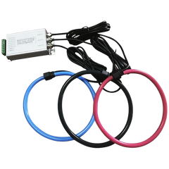



IIoT devices, equipment , connectivity, data analytics and users
IP network
IP network
Cloud
Machine operator
Expert, auditor
Control & Monitoring System
Field Network:
bus, W-mod
RTU mod
Mesh router
GATEWAY
Ethernet
Sensors: Pressure, Flow,
PDP, Temp, Vib..
El.Power/current
Compressor #1
Compressor #2
Compressor #8
Service Providers
Notes:
CALMS is an innovative Energy Management System designed to optimize compressed air systems, enhancing efficiency and sustainability in industrial settings.
By integrating advanced monitoring, real-time analytics, and predictive maintenance, CALMS ensures operational excellence, reduces energy consumption, and minimizes environmental impact.
It's the go-to solution for businesses seeking to improve their energy management and achieve cost-effective, eco-friendly operations.

Slide 7

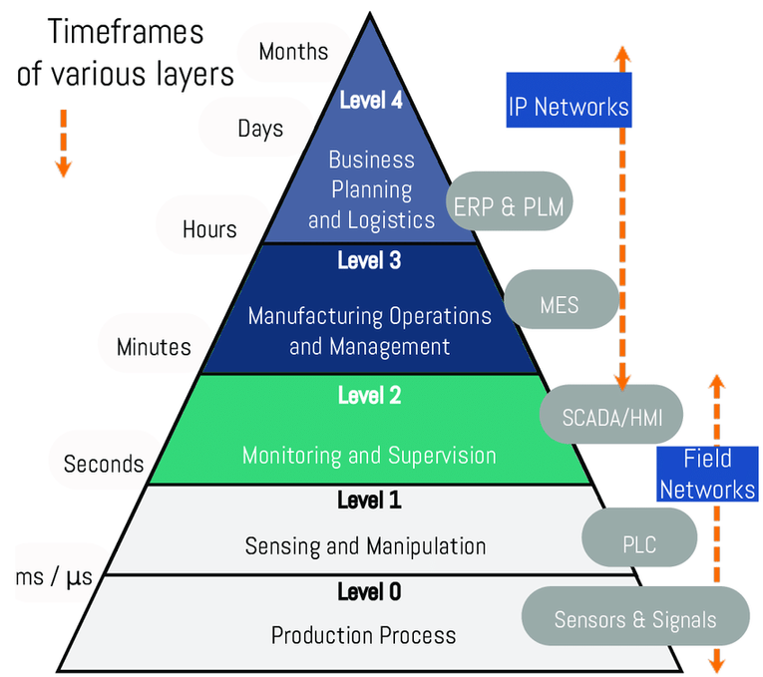
DATA STRUCTURE INTEGRATION & SECURITY
Compressed air management system can be integrated to majority of high level information systems:
  Building management systems (BMS)
  Energy management systems (EMS)
  Enterprise resource planning (ERP) systems
  Manufacturing execution systems (MES)
  Supervisory control and data acquisition (SCADA) systems
Using standards:
  ISA-95 IEC 62264: Industrial Integration Standard
  ISA/IEC 62443: Industrial Security Standard
  ISO/IEC 27001: Information Security for ISMS
PLC level integration - using Field Networks (Modbus, ADS, OPC, Profibus...)
Server level integration - using IP Networks via API (Application Programming Interface) in json format or xml
  SSO - Single Sign-On, is an authentication process that allows users to access multiple applications - option
  MFA - Multi-Factor Authentication - security measure that requires users to provide more verification factors to access an account or system
Notes:
CALMS is an innovative Energy Management System designed to optimize compressed air systems, enhancing efficiency and sustainability in industrial settings.
By integrating advanced monitoring, real-time analytics, and predictive maintenance, CALMS ensures operational excellence, reduces energy consumption, and minimizes environmental impact.
It's the go-to solution for businesses seeking to improve their energy management and achieve cost-effective, eco-friendly operations.

Slide 8




Holistic IIoT: Connecting All Stakeholders for Smarter Compressed Air Management
End users - companies
  Optimization of energy and personnel costs,
  Supervision of suppliers, service providers and investors
  Compliance with ISO directives and standards
  Maintenance & system reliability
  Comparison with best in class, TCO, KPI
Independent experts, auditors
  Analysis, energy audits, system verification, edjucation
ESCO - investors
  Identification of savings, investment, energy sales, remote monitoring ..
Service companies - maintenance workers
  Sales of services, customer supervision, acquiring new customers, retaining existing customers, 24/7 support
Equipment suppliers - OEM
  Remote control, comparative analysis, aftermarket, new efficient products
Notes:
CALMS is an innovative Energy Management System designed to optimize compressed air systems, enhancing efficiency and sustainability in industrial settings.
By integrating advanced monitoring, real-time analytics, and predictive maintenance, CALMS ensures operational excellence, reduces energy consumption, and minimizes environmental impact.
It's the go-to solution for businesses seeking to improve their energy management and achieve cost-effective, eco-friendly operations.

Slide 9
Holistic Systems Create Big Data – AI Makes It Valuable
Holistic management system collects vast amount of data from:
  IIoT Devices: Compressors, dryers, sensors, controllers
  Digital Daily Logs: Mobile + NFC = finally useful, structured input
  Employee Engagement: Real-world improvement suggestions
  Audits & System Reviews: Periodic in-depth insights
  Waste Mapping: Identifying losses at end-use points
  Maintenance & Monitoring: Continuous system health data
The Challenge
  Too much data, not enough time or resources to process and act on it
The Solution: AI
  Filters noise, finds patterns
  Highlights what really matters
  Helps prioritize actions
  Supports decision-making across all levels
Notes:
CALMS is an innovative Energy Management System designed to optimize compressed air systems, enhancing efficiency and sustainability in industrial settings.
By integrating advanced monitoring, real-time analytics, and predictive maintenance, CALMS ensures operational excellence, reduces energy consumption, and minimizes environmental impact.
It's the go-to solution for businesses seeking to improve their energy management and achieve cost-effective, eco-friendly operations.

Slide 10
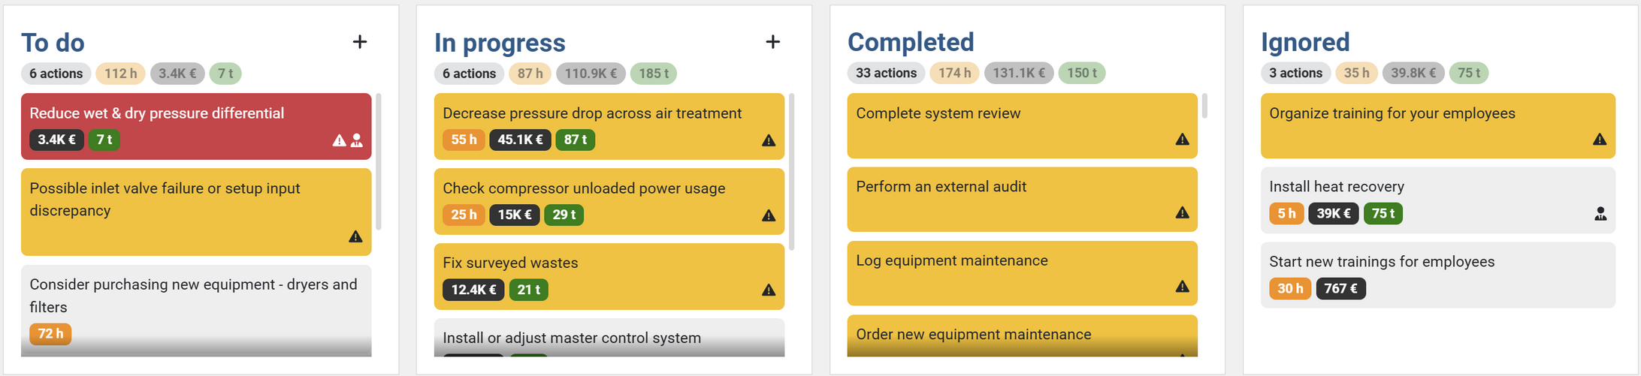

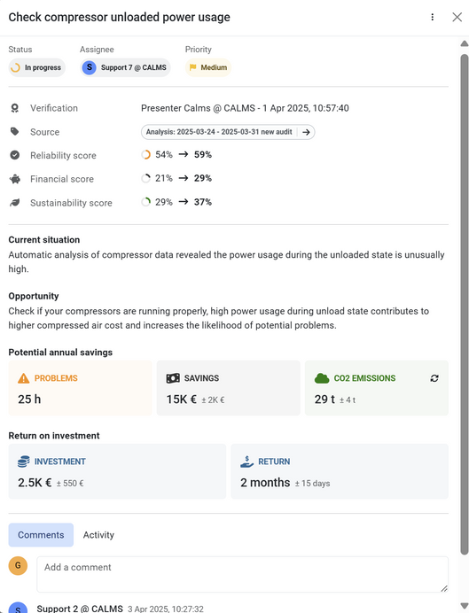
Action cards = result of auto-analyser on big data
Verification by experts!
Notes:
CALMS is an innovative Energy Management System designed to optimize compressed air systems, enhancing efficiency and sustainability in industrial settings.
By integrating advanced monitoring, real-time analytics, and predictive maintenance, CALMS ensures operational excellence, reduces energy consumption, and minimizes environmental impact.
It's the go-to solution for businesses seeking to improve their energy management and achieve cost-effective, eco-friendly operations.

Slide 11
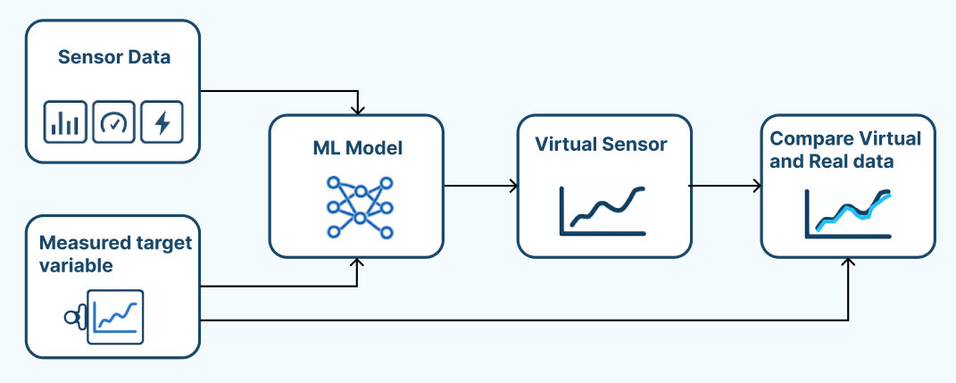
Usecase #1 : What is a Virtual sensor ? Digital Twin
  A virtual sensor is a calculated signal, not a physical device
  It uses machine learning to estimate a value (like flow or power)
  Trained on existing collection of sensor data (10-100 chanels)
  Works alongside your real sensors, in real time
Notes:
CALMS is an innovative Energy Management System designed to optimize compressed air systems, enhancing efficiency and sustainability in industrial settings.
By integrating advanced monitoring, real-time analytics, and predictive maintenance, CALMS ensures operational excellence, reduces energy consumption, and minimizes environmental impact.
It's the go-to solution for businesses seeking to improve their energy management and achieve cost-effective, eco-friendly operations.

Slide 12
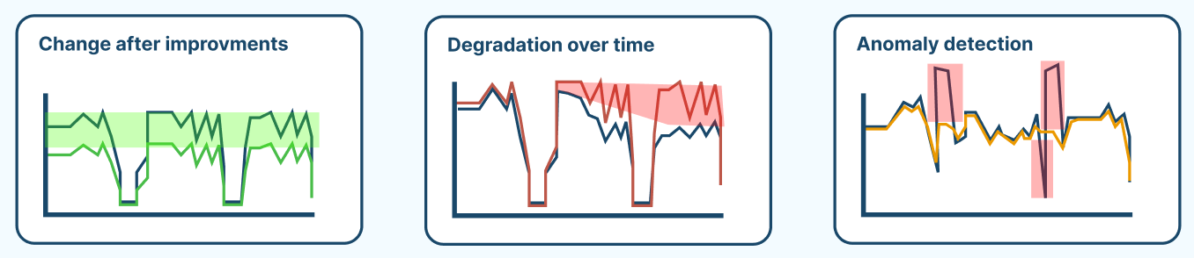
Why Use Virtual Sensor ?
  Spot inefficiencies and anomaly
  Use it as a base line to se improvements or degradation of the system
  it can serve as a redundancy sensor: flow calculation from CFC valve data
Notes:
CALMS is an innovative Energy Management System designed to optimize compressed air systems, enhancing efficiency and sustainability in industrial settings.
By integrating advanced monitoring, real-time analytics, and predictive maintenance, CALMS ensures operational excellence, reduces energy consumption, and minimizes environmental impact.
It's the go-to solution for businesses seeking to improve their energy management and achieve cost-effective, eco-friendly operations.

Slide 13
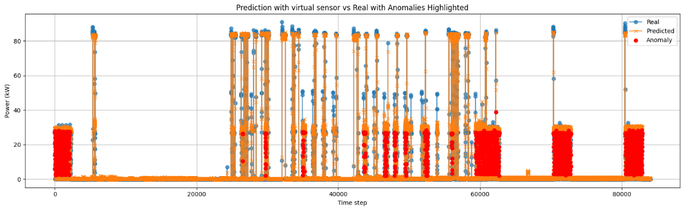
Usecase #2: Inefficient power consumption of one compresor in system
Model: Gradient boosting
Data: 6 months of data, 52 channels
Each compressor in system have virtual sensor trained on historical data
Model detected anomaly in current operation that differs from historic operation
Notes:
CALMS is an innovative Energy Management System designed to optimize compressed air systems, enhancing efficiency and sustainability in industrial settings.
By integrating advanced monitoring, real-time analytics, and predictive maintenance, CALMS ensures operational excellence, reduces energy consumption, and minimizes environmental impact.
It's the go-to solution for businesses seeking to improve their energy management and achieve cost-effective, eco-friendly operations.

Slide 14
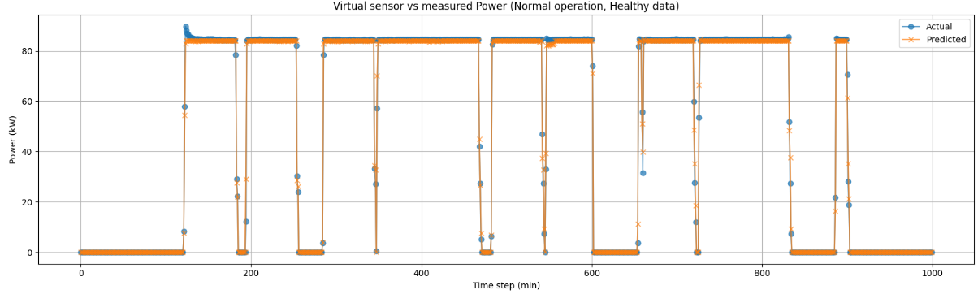
How it works
To build a reliable virtual sensor, we first need 1-6 months of normal operating data from your compressed air system.
This historical data forms the baseline the ML model learns from.
Closer the actual and predicted data are the better our baseline is.
Notes:
CALMS is an innovative Energy Management System designed to optimize compressed air systems, enhancing efficiency and sustainability in industrial settings.
By integrating advanced monitoring, real-time analytics, and predictive maintenance, CALMS ensures operational excellence, reduces energy consumption, and minimizes environmental impact.
It's the go-to solution for businesses seeking to improve their energy management and achieve cost-effective, eco-friendly operations.

Slide 15
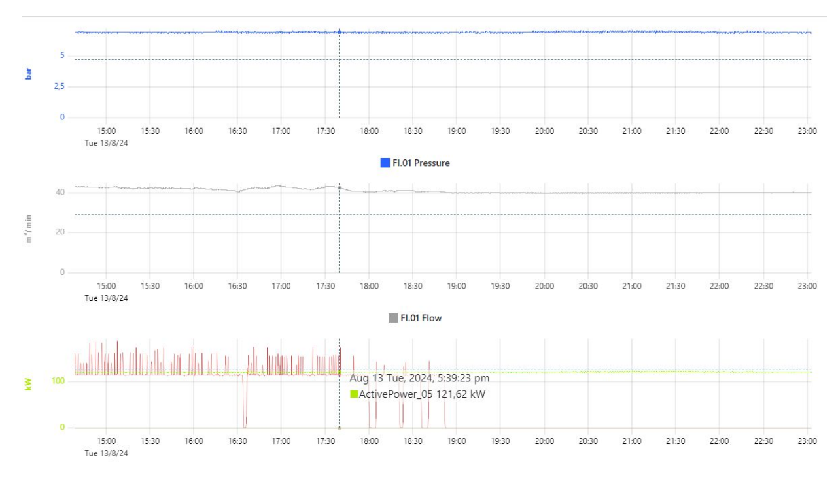
Usecase #3: System reliability / redundancy
Problems detected #1
Compressor C.01 service/replace
Compressor C.01 - Load/Unload power is the same, not delivering any air to the system
SAVINGS POTENTIAL:
105kW
SOLUTION:
1.Replace compressor and add control
2.Service compressor and add control
Notes:
CALMS is an innovative Energy Management System designed to optimize compressed air systems, enhancing efficiency and sustainability in industrial settings.
By integrating advanced monitoring, real-time analytics, and predictive maintenance, CALMS ensures operational excellence, reduces energy consumption, and minimizes environmental impact.
It's the go-to solution for businesses seeking to improve their energy management and achieve cost-effective, eco-friendly operations.

Slide 16

THANK YOU !
Any questions ?
gorazd@calms.com
Central Europe
CALMS d.o.o.
Dolenjska cesta 83
1000 Ljubljana, Slovenia
E: info@calms.eu
T: +386-41-432-202
www.calms.com
North America
CALMS AIR INC.
6050-C Highway 14 Gray Court, SC 29645, USA
E: info.us@calms.com
T: +1-864-705-2571
www.calms.com
Nordic Europe
CALMS Nordic AB
Linnégatan 30
413 04 Göteborg, Sweden
E: info@calms.com
T: +46-31-757-15-15
www.calms.com
Notes:
CALMS is an innovative Energy Management System designed to optimize compressed air systems, enhancing efficiency and sustainability in industrial settings.
By integrating advanced monitoring, real-time analytics, and predictive maintenance, CALMS ensures operational excellence, reduces energy consumption, and minimizes environmental impact.
It's the go-to solution for businesses seeking to improve their energy management and achieve cost-effective, eco-friendly operations.

